Slide 1
Introduction to Java for C++ Programmers
Understanding Distributed Computation in Java using RMI
Professor: Reza Khojasteh

Slide 2
Understanding Distributed Computation in Java using RMI
Remote Method Invocation (RMI) is the action of invoking a method on a remote object and is one of the approaches to distributed computing in Java.
Remote object is an object whose methods can be invoked from another Java virtual machine.
Remote interface is an interface that declares a set of methods that may be implemented by a remote Java virtual machine:
public interface BankAccount extends java.rmi.Remote {
public void deposit(float amount) throws java.rmi.RemoteException;
}

Slide 3
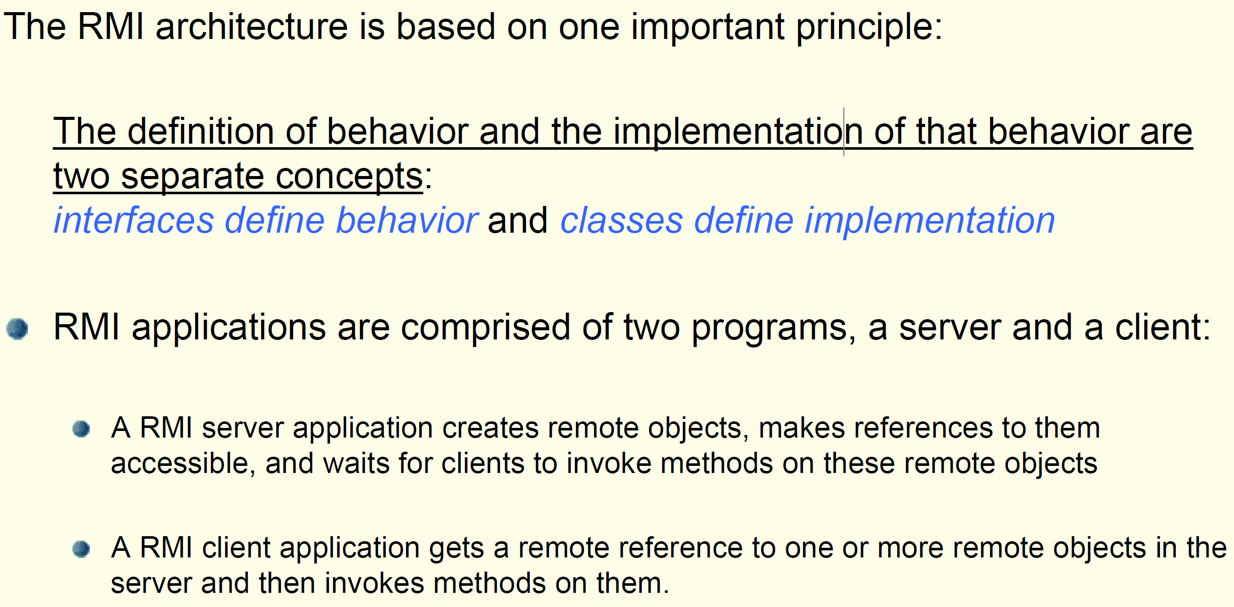
Distributed Objects

Slide 4
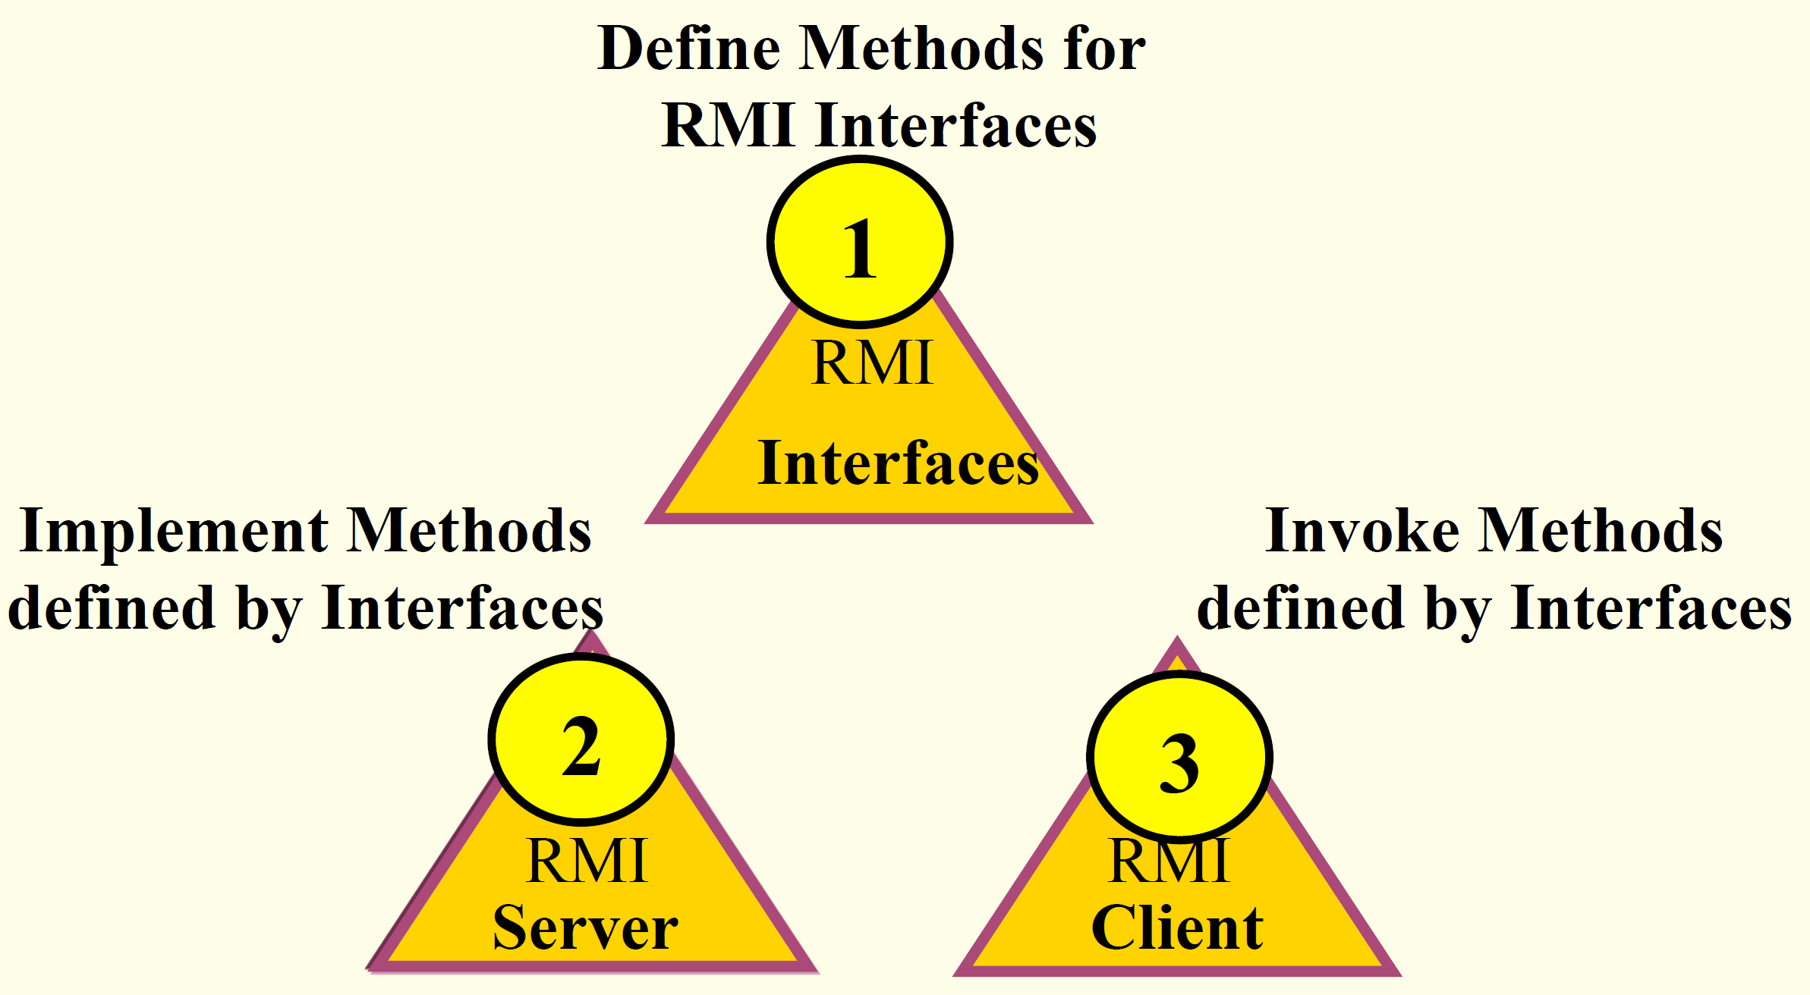
RMI System Design

Slide 5
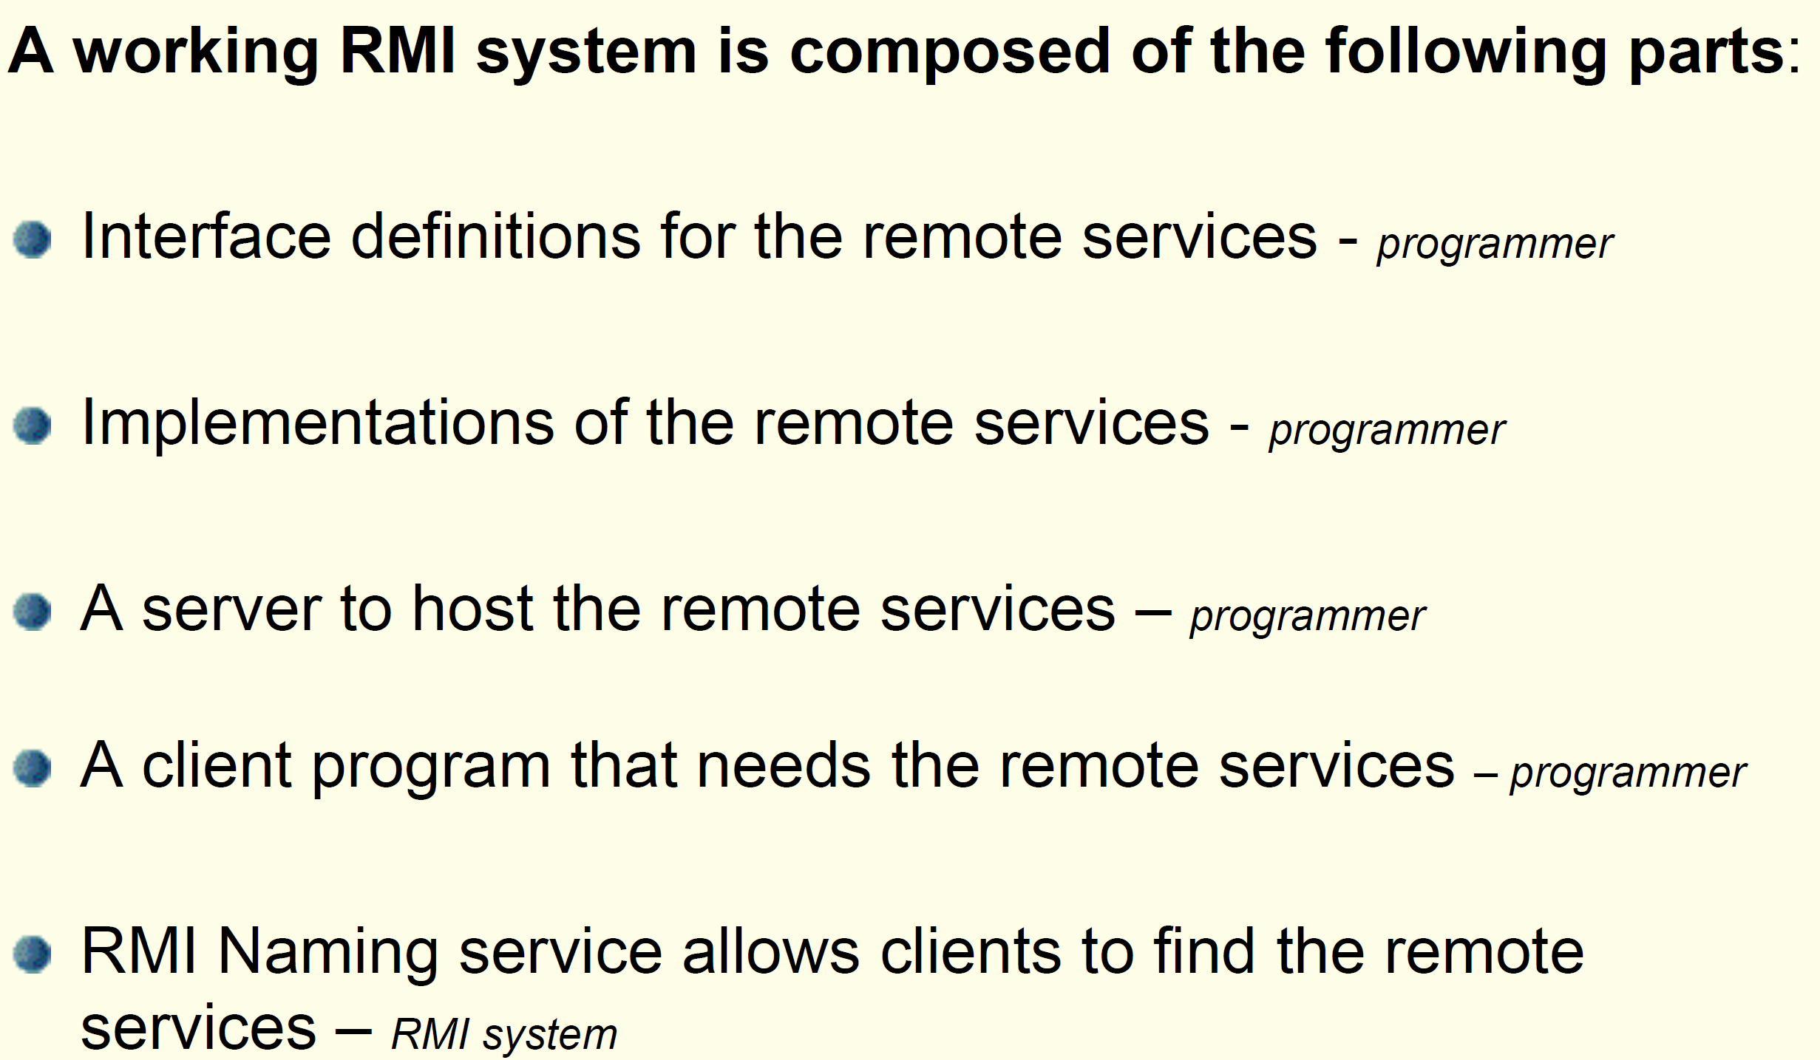
RMI System Parts

Slide 6
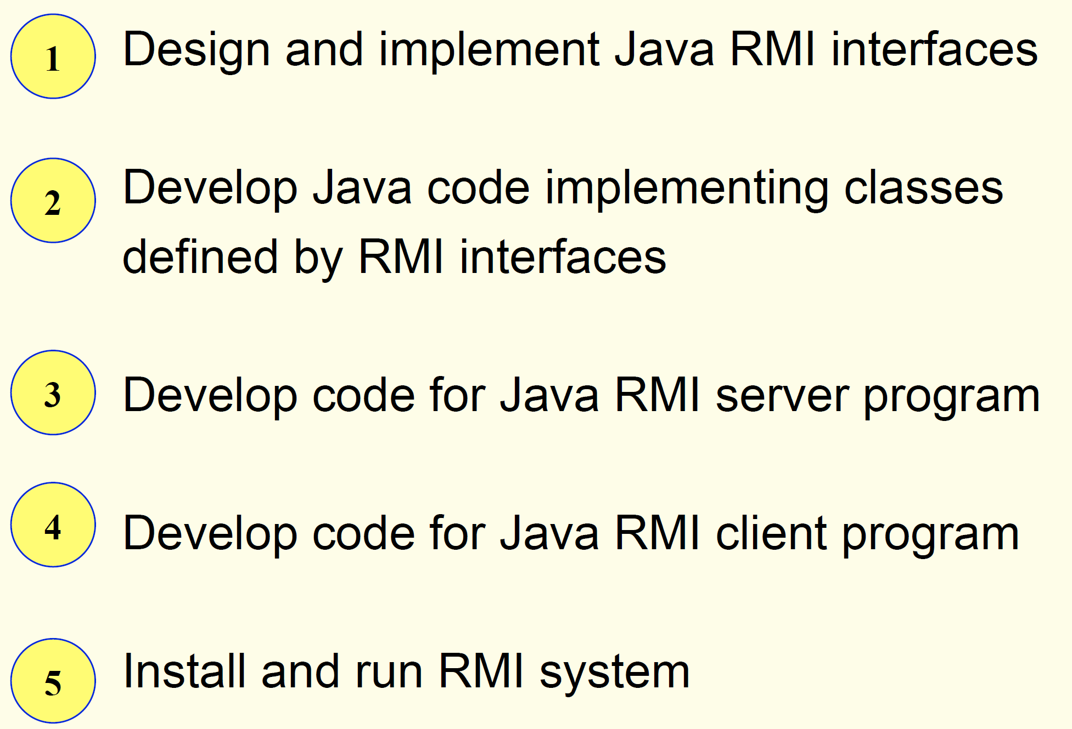
Building a RMI System

Slide 7
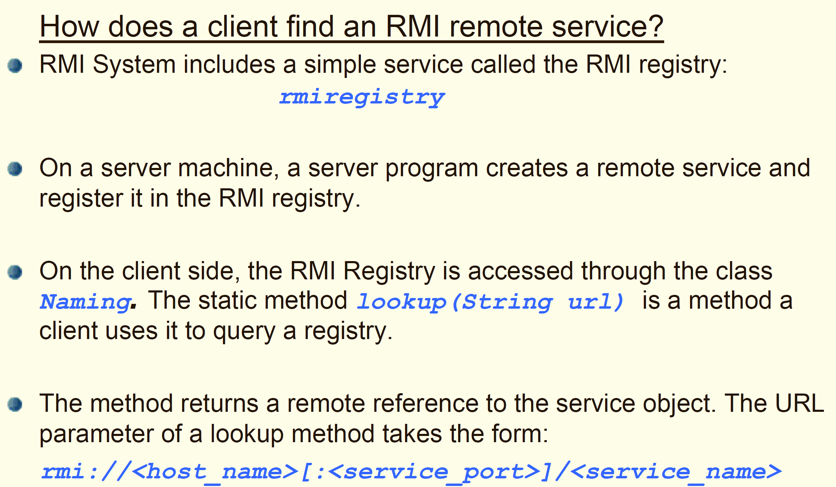
Naming Remote Objects

Slide 8
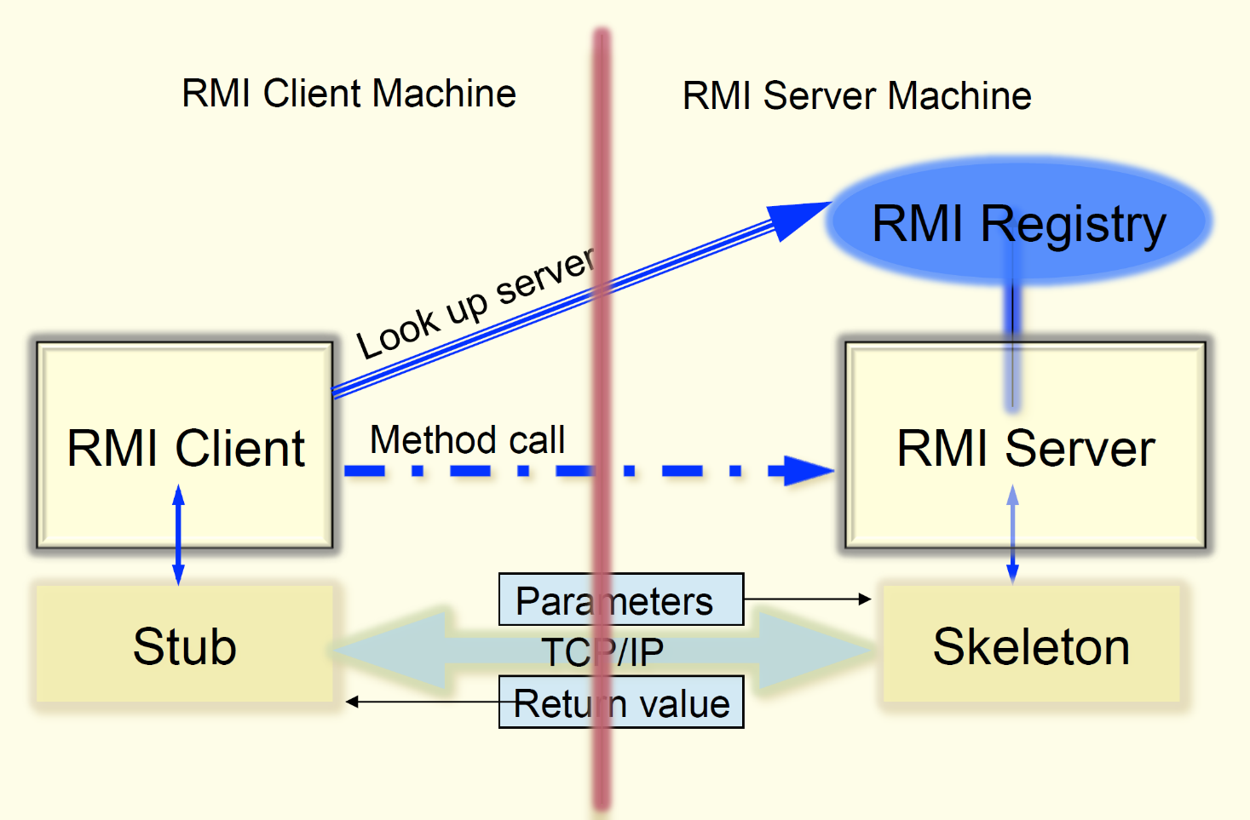
Overview of RMI Architecture

Slide 9
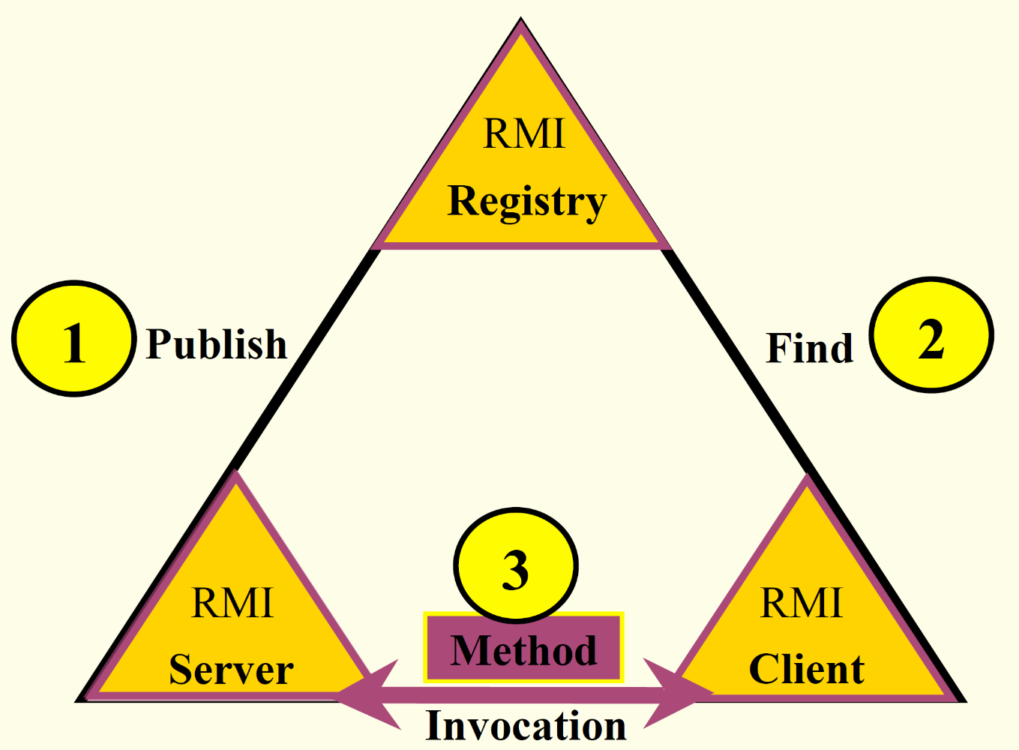
Running RMI System

Slide 10
Understanding Distributed Computation in Java using RMI Thorough Some Examples
Please check Hello.java, HelloImpl.java, HelloServer.java, and HelloClient.java.
Please check Calculator.java, CalculatorImpl.java, CalculatorServer.java, and CalculatorClient.java.

